Slide 1


Health, safety and wellbeing training awareness package
Chemical management processes

Slide 2

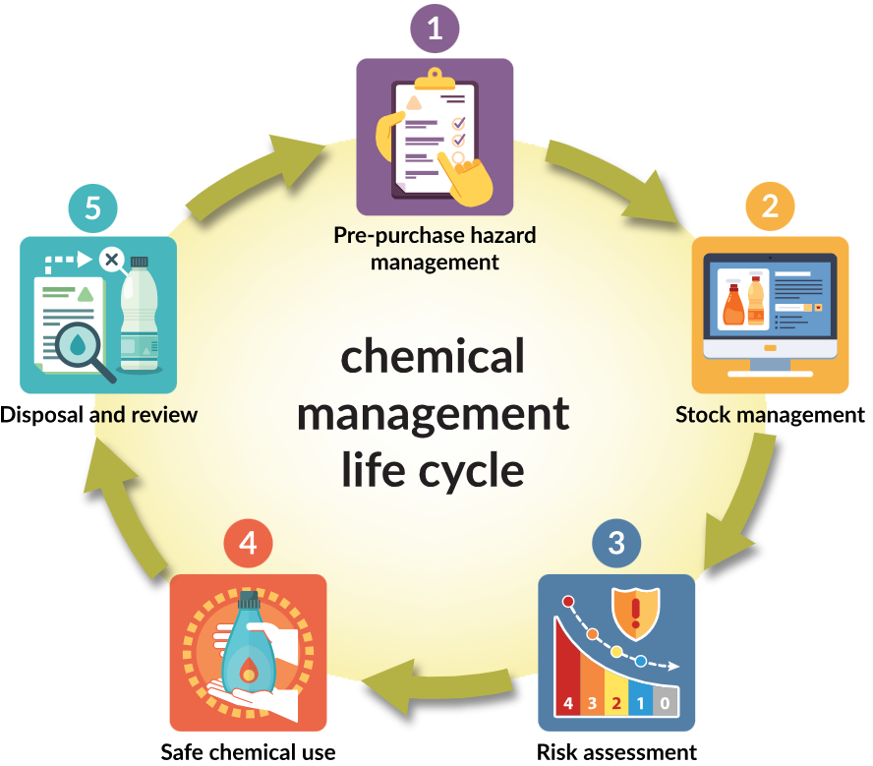
The Department
of Education
chemical management system
Notes:
You may already know about the Department of Education’s chemical management system.
The processes within this system are important as they ensure chemical risks are managed safely.
As chemicals need to be managed over extended periods of time, a life cycle approach is taken, with the workplace roles throughout coordinated by a Chemical Management Plan.
A recent review of chemical management practices in schools identified some gaps regarding the implementation of basic requirements, such as:
a Chemical Management Plan not being available;
Pre-purchase Chemical Risk Assessments not being completed; and
a lack of understanding regarding the requirements for Safety Data Sheets (SDS).
Looking at the life cycle process, we can see that these gaps lie within some important components of the BEGINNING of the chemical management life cycle.

Slide 3





Chemical management plans
Make sure your workplace is
aware of the requirements for:
Pre-purchase chemical risk
Access to safety data sheets
Notes:
Chemical Management Plans, Pre-purchase Chemical Risk Assessments, and Safety Data Sheets contain important chemical safety information.
When these critical requirements are satisfied, it makes it simple to identify risks from chemicals, and manage them safely.
It is important to ensure that these documents are completed, maintained as current, and made readily available to chemical users.
Train staff in the purpose and location of these documents.

Slide 4

Chemical management plans
Every workplace requires a Chemical management plan (CMP).
The CMP:
formally assigns roles and responsibilities for chemical management across the workplace
clearly specifies the actions required to ensure safety and compliance
helps to ensure chemicals are being safely managed.
Notes:
Chemical Management Plan (CMP) template: https://education.qld.gov.au/initiativesstrategies/Documents/chemical-management-plan.pdf
Your site may take a single or multi-plan approach depending on the quantity, distribution, and risk levels of chemicals at your workplace.
CMP example - single plan approach: https://intranet.qed.qld.gov.au/Services/HumanResources/payrollhr/healthwellbeing/abouthealthsafetywellbeing/resources/Documents/chemical-management-plan-single-plan-approach-example.pdf
CMP example - multi-plan approach: https://intranet.qed.qld.gov.au/Services/HumanResources/payrollhr/healthwellbeing/abouthealthsafetywellbeing/resources/Documents/chemical-management-plan-multi-plan-approach-example.pdf
Chemical management is everyone's responsibility, and works best in larger workplaces when each curriculum or operational area manages its own chemicals, with its own CMP and assigned roles. Tasks may then be shared among a larger number of staff members.
School leaders can find more information about CMPs in the key messages for principals – chemical management factsheet:
https://intranet.qed.qld.gov.au/Services/HumanResources/payrollhr/healthwellbeing/abouthealthsafetywellbeing/resources/Documents/key-messages-for-principals-chemical-management-procedure.pdf

Slide 5
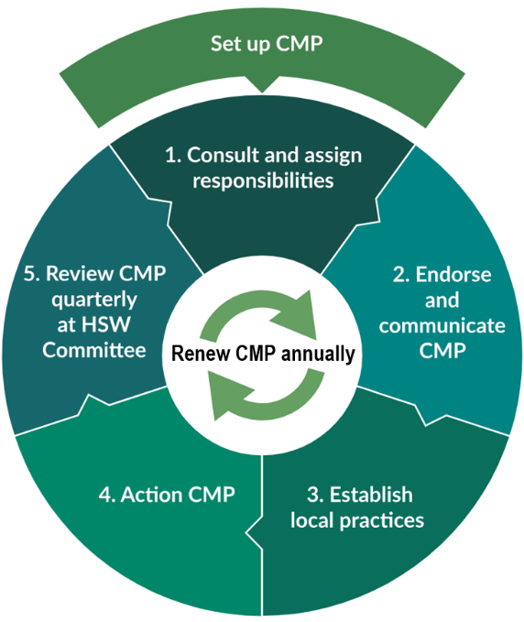
Chemical management plans
It is a standing agenda item at
all Health, Safety and Wellbeing Committee meetings to monitor
CMP implementation and progress.
Notes:
CMPs must be renewed annually, and brought to the HSW Committee for endorsement, to ensure that the roles assigned are current, and that chemical risks are being adequately managed across the workplace.

Slide 6
Pre-purchase chemical risk assessments
A Pre-purchase chemical risk assessment must be completed
and approved before the introduction of any chemical into the workplace.
Completing the pre-purchase risk assessment process ensures:
safer alternatives are considered
minimum quantities are procured
an SDS for the chemical is available and hazards are identified
appropriate labels, storage locations, PPE, engineering controls,
and disposal methods are available to manage risk.
Notes:
The staff member responsible for approving the assessment, and the staff member responsible for managing completed assessments are assigned as part of the Chemical Management Plan.
A prepurchase assessment must be formally reviewed every 5 years to ensure that the stated controls in place for a chemical continue to adequately manage the hazards.
See the following links for examples of completed pre-purchase risk assessments for:
a single chemical purchase: https://intranet.qed.qld.gov.au/Services/HumanResources/payrollhr/healthwellbeing/abouthealthsafetywellbeing/resources/Documents/pre-purchase-chemical-risk-assessment-single-chemical-example.pdf
multiple chemicals with similar properties: https://intranet.qed.qld.gov.au/Services/HumanResources/payrollhr/healthwellbeing/abouthealthsafetywellbeing/resources/Documents/pre-purchase-chemical-risk-assessment-multiple-chemicals-example.pdf

Slide 7
Safety data sheets (SDS)
SDS hold important safety information about chemical hazards and how to manage them.
You will need to obtain a vendor SDS for each chemical and add it to your manifest within Chemwatch as part of the Pre-purchase chemical risk assessment process.
You can search for an SDS within Chemwatch and
drag and drop it into your manifest.
Notes:
A ‘vendor’ SDS is one written by the manufacturer/importer/supplier of the chemical.
A vendor SDS can be sourced directly from suppliers or manufacturers, or found by searching the Chemwatch online library of SDS.
Complete a stocktake each year to ensure that the list of chemicals in your Chemwatch manifest and SDS match the chemicals on site.

Slide 8
Safety data sheets
SDS must be made available and readily accessible to anyone using a hazardous chemical.
All chemical users must be trained in the purpose and location of SDS.
Workplace managers must ensure that all chemical users
know how to access SDS at their workplace whenever needed.
Notes:
Determine, in consultation with relevant employees, if SDS are to be made readily accessible ONLINE in Chemwatch or a network location, or OFFLINE as hard copies.
Chemwatch will automatically update your SDS. If you store SDS outside this program, remember that you must manually replace them to ensure they stay current.
An SDS is only valid for five years from its Issue Date.

Slide 9


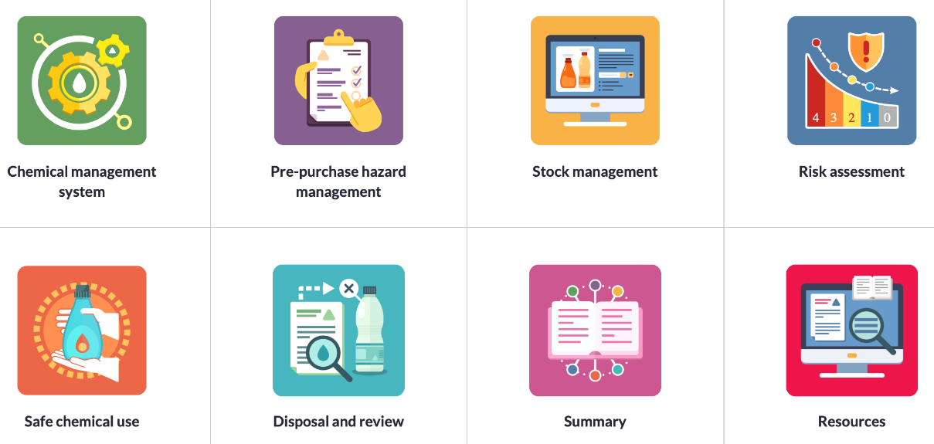
Enrol in the Chemical Management course within the
EFI catalogue for more comprehensive information on all stages
of the Department of Education’s chemical management system.
Notes:
Chemical Management course: https://catalogue.qlearn.eq.edu.au/browse/education-futures-institute/courses/chemical-management

Slide 10


For further information
Chemical management procedure
Chemical management guideline
Chemical management system flowchart
Chemical management procedure
quick check for principals
Notes:
Hyperlinks are provided on the buttons above.
Chemical Management Procedure: https://ppr.qed.qld.gov.au/pp/chemical-management-procedure
Chemical Management System flowchart: https://ppr.qed.qld.gov.au/attachment/chemical-management-system-flowchart.pdf
Chemical Management Guideline: https://intranet.qed.qld.gov.au/Services/HumanResources/payrollhr/healthwellbeing/abouthealthsafetywellbeing/resources/Documents/chemical-management-guideline.pdf
Chemical Management Procedure – quick check for Principals: https://education.qld.gov.au/initiativesstrategies/health-safety-wellbeing/Documents/chemical-management-procedure-quick-check.pdf
Access to Chemwatch via: https://jr.chemwatch.net/

