Slide 1
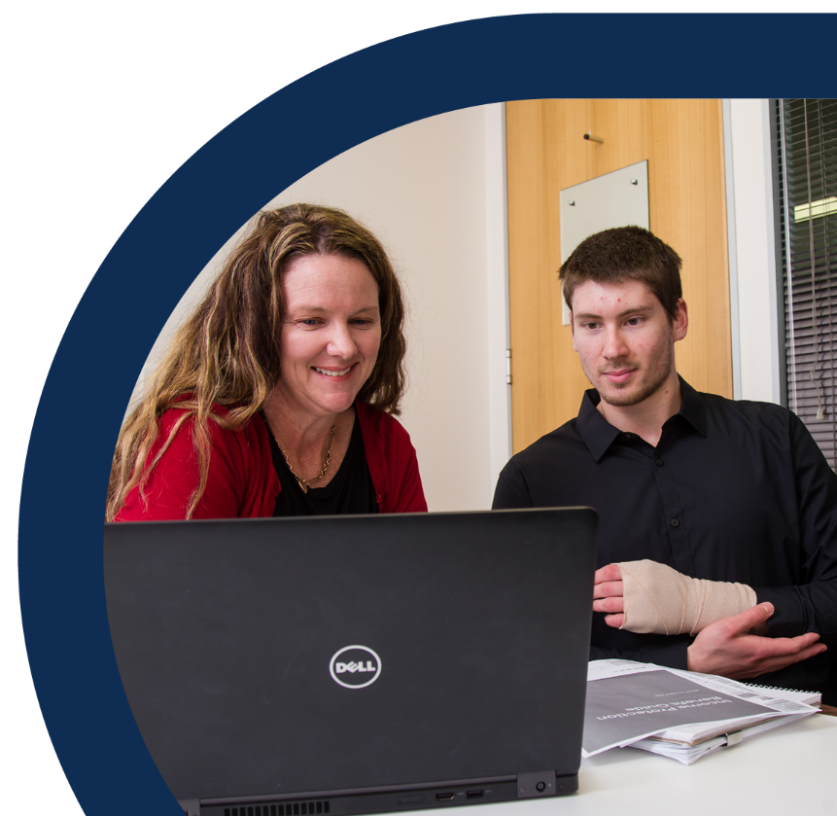
Health, safety and wellbeing training awareness package
The rehabilitation and return to work process
Notes:
In January 2024 the Department of Education entered into an enforceable undertaking with Queensland's work health and safety regulator.
Under the enforceable undertaking, a sample of Central Queensland schools completed a Safety Capability Survey in collaboration with the Office of Industrial Relations.
It was an enforceable undertaking commitment that the results of these initial Safety Capability Surveys subsequently inform the development of Health, Safety and Wellbeing Training Awareness Packages to address any gaps identified.
This resulted in slides on the ‘rehabilitation and return to work process’ being distributed within Health, Safety and Wellbeing Committee Packs for presentation at Term 4 2024 HSWC meetings.
In consultation with Principals from the sample group, these slides have been repackaged with some additional material, and published under the title HSW Training Awareness Package 2024 - The Rehabilitation and Return to Work Process.

Slide 2
What to do following an injury or illness – the rehabilitation and return to work process
Notification of illness or injury
Rehabilitation support
Returning to work
Review and monitor plan
Conclusion of rehabilitation
1
2
3
4
5
Notes:
Workplace rehabilitation is a process for assisting injured or ill staff during their recovery to achieve an early, safe and sustained return to meaningful and productive work.

Slide 3
What to do following an injury or illness – the rehabilitation and return to work process
Notification of illness or injury
1
Notify your supervisor immediately if there is any injury, illness, incident, or condition impacting your work life, so that you receive support.
Seek medical treatment and certificates as needed for your injury/illness.
Report an incident through the MyHR WH&S system in the case of a work-related injury or illness.
Make contact with your school Rehabilitation and Return to Work Coordinator (RRTWC).
Make a WorkCover claim for work-related injury or illness if required.
Notes:
Your Rehabilitation and Return to Work Coordinator has all the information and training you need, and can guide you through the entire rehabilitation process.
If impacted, obtain a work capacity certificate from your treating doctor and forward a copy to your supervisor or RRTWC as soon as possible.
A work capacity certificate contains more information than a standard medical certificate, including any restrictions you may have in completing certain tasks or functions, and any workplace modifications or considerations that are needed to support you in your return to work.

Slide 4
What to do following an injury or illness – the rehabilitation and return to work process
Notification of illness or injury
Rehabilitation support
1
2
Rehabilitation and Return to Work Coordinators to make early contact
Early support is critical for recovery and positive return to work outcomes.
School leadership must ensure ongoing communication and support for injured, ill and/or absent staff.
Medical certificates are provided for absences of more than 3 days.
Notes:
School leaders have responsibility for ensuring that leave is correctly applied for absences from work, and that the leave is promptly approved to ensure correct wage payments to staff.
Maintain clear communication lines and keep the workplace’s MyHR WH&S location page up to date with current RRTWC contact details, to ensure that RRTWCs are notified asap of staff injuries.

Slide 5
What to do following an injury or illness – the rehabilitation and return to work process
Notification of illness or injury
Rehabilitation support
Returning to work
1
2
3
Early return to school is crucial for recovery and positive health outcomes.
Consultation with medical professionals informs a Graduated Return to Work Plan if necessary.
Your school will support you to modify work processes and the environment if medically necessary, and find suitable and meaningful duties to support your early return and recovery.
Notes:
There is compelling evidence as to the health benefits of good work. Being absent from the workplace and established routines can have a negative effect on mental health, including increased anxiety about the return to work process, and feelings of helplessness. Ongoing support, and an early return to work and routine, is vital to recovery.

Slide 6
What to do following an injury or illness – the rehabilitation and return to work process
Notification of illness or injury
Rehabilitation support
Returning to work
Review and monitor plan
1
2
3
4

Slide 7
What to do following an injury or illness – the rehabilitation and return to work process
Notification of illness or injury
Rehabilitation support
Returning to work
Review and monitor plan
Conclusion of rehabilitation
1
2
3
4
5
Seek a medical clearance certificate to manage workplace health and safety risks.
Notes:
The primary goal of workplace rehabilitation is to return staff to their pre-injury role and work location wherever possible.
Everyone benefits from staff recovering and returning to safe and sustainable work.

Slide 8
WorkCover has an appeals process available.
Employment must be a ‘significant contributing factor’ for WorkCover Queensland to consider the injury work-related.
All WorkCover claims are considered on an individual basis, and Queensland’s statutory workers’ compensation scheme is a no fault scheme.
Employees may also be covered by WorkCover when injured travelling to and from work, or travelling for work.
Notes:
During consultation with Principals following completion of the Safety Capability Survey, further information was requested regarding ‘what constitutes a work-related injury’.

Slide 9
We all experience periods of injury or illness.
Keys to recovery
Early contact and support
Ongoing leadership communication with staff
Consultation with medical professionals
Early return to agreed tasks
The Department of Education assists and supports over 1,000 staff every year in successfully returning to work.

Slide 10
Your workplace Rehabilitation and Return to Work Coordinator has all the information you need, and can guide you through the rehabilitation process
Aaron Sample
sampl98@eq.edu.au
extension 998
Anne Sample
sampl99@eq.edu.au
extension 999
Notes:
NOTES:
The Annual Safety Assessment 2024 requires evidence that staff have been reminded of their role in the rehabilitation process annually (ASA 2024 Q 9.2). Slides 2-7 from this package (and any other slides as desired) may be copied and transferred into annual WH&S refresher training and/or other presentations as needed, to fulfil this requirement.
The Annual Safety Assessment 2024 also requires that Principals ensure all employees know who the RRTWC is for their workplace (ASA 2024 Q 9.2 Guidelines). This slide, slide 10, may be personalised and copied into presentations and/or printed for display as needed.

