Slide 1
Issued Nov 2025. V1

Slide 2
Managing welding fumes in schools
This presentation material has been provided to facilitate discussion at your school with relevant ITD staff about the effective management of welding fumes. Information can be delivered at an ITD faculty meeting, tool-box talk or other local PD session. Local information can be added for your site context. An information sheet is also provided.
Relevant information can also be incorporated into safety content for students involved with welding practices.

Slide 3
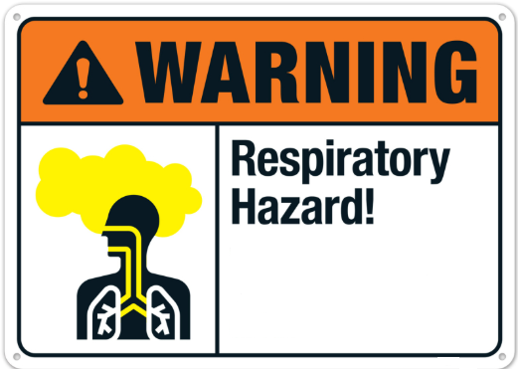
Managing welding fumes in schools
In 2024 Safe Work Australia announced a reduction to the workplace exposure standard (WES) for welding fumes.
The 8-hour time weighted average (TWA) of 5mg/m³ was reduced to 1mg/m³.
Welding fume is a complex mix of small particles or substances which can be easily inhaled. These have the potential to cause short, or long term health effects
Good management of welding fumes can effectively protect people during welding activities
Resources:
WorkSafe Queensland
WorkSafe NSW

Slide 4
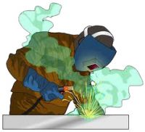
Managing welding fumes in schools
What are the health effects?
Short-term effects include throat and lung irritation, temporary reduced lung function and metal fume fever.
Long-term effects include asthma, pneumonia, cancer, and damage to the nervous system
What two factors are likely to lead to high fume exposure?
Time/duration - high volume of continuous welding activities.
Volume/amount – e.g caused by poor ventilation with head positioned in the fume path

Slide 5
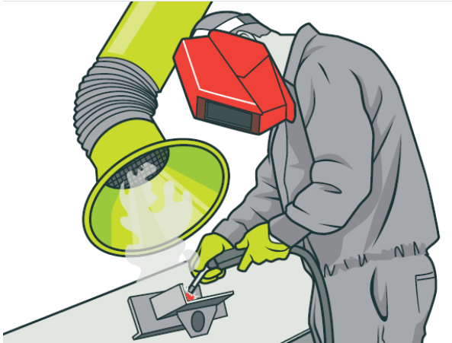
Managing welding fumes in schools
Before starting to weld confirm:
Staff have a thorough understanding of the welding task, how it should be conducted and the equipment
Suitable PPE is available and in good condition
Materials for welding are prepared appropriately
The setup is correct and effective ventilation is available in good working order
Adjacent work and ensure that others nearby are not going to be impacted by the welding task
During welding
Avoid welding materials with coatings if possible
Ensure PPE is properly worn
Avoid accidental contact with the electrical/welding circuit - don’t lean against bench or work piece

Slide 6

What processes are in place at your school?
Staff involved in welding processes understand how to ensure effective management of welding fumes.
School staff understand to regularly report on the condition/effectiveness of mechanical ventilation equipment / local exhaust ventilation (LEV)
All ITD staff are aware of the process to report faulty or broken equipment. This includes the process to Lockout & Tagout equipment as required.
Any fixed mechanical ventilation equipment is included on the annual service maintenance program and
  an inspection report is provided to the school annually and
  Items are reviewed and actioned.
Resources
Welding processes - Code of Practice 2021
Weld Australia – free online courses
HSE – Welding controls

