Slide 1
Workplace induction for schools officers
Reviewed March 2022 V4
Notes:
All staff are required to participate in an induction process.
The induction process includes a number of elements including Mandatory All Staff Training (MAST) which includes health, safety and wellbeing (HSW) information.
This ‘workplace induction for schools officers’ should be conducted after the general MAST presentation has been completed.
Local information is to be incorporated into this presentation to make it relevant for your site.
Other health, safety and wellbeing information is available at: https://education.qld.gov.au/initiatives-and-strategies/health-and-wellbeing/workplaces

Slide 2
Induction resources
Schools officer induction and other resources can be accessed at:
https://education.qld.gov.au/initiatives-and-strategies/health-and-wellbeing/workplaces/safety/managing/school-officers
Notes:
Right click on hyperlink and select “open hyperlink”

Slide 3
Policies and procedures
Employment details
  Pay details, general working conditions, personal details.
Corporate documents
  Code of conduct, procedures register, Creating Healthier Workplaces website
Local procedures
  Emergency procedures, purchasing, security
Notes:
Ensure that your Schools officer has provided details for payment of wages and personal details such as emergency contact. Explain general working conditions, areas of responsibility, work schedules.
See the Oneportal Schools Officers- Grounds and Facilities page for more information: https://intranet.qed.qld.gov.au/Services/HumanResources/payrollhr/awardspayscales/conditionsemployment/Pages/school-officers-grounds-facilities.aspx
Explain Code of Conduct, relevant PPR policies/procedures, review the EQ Intranet site (OnePortal), Creating Healthier Workplaces website and other relevant websites.
Review local procedures including
Emergency procedures
Reporting hazards and incidents
First aid arrangements
Purchasing procedures including Sun smart clothing and chemicals
School security procedures
School meeting and communication practices/protocols
Other general procedures as required

Slide 4
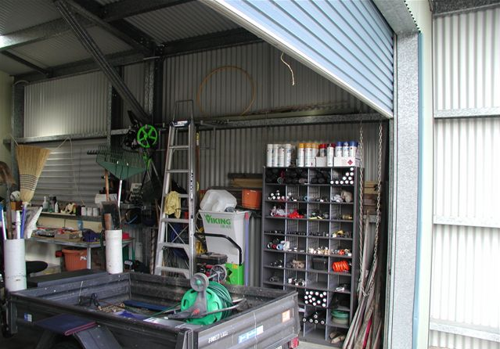
Housekeeping
Notes:
First and foremost, safe work practices start in and around your shed.
Good house-keeping practices in and around your shed will reduce the risk of injury to you while performing your normal tasks.
The risk of injury to other staff and students in the vicinity of the shed is also minimised from associated hazards.
Good housekeeping principles should also apply when working with machinery/equipment/materials around the school.
Keep your work area clean and tidy. This includes both in and around your shed.
Dispose of rubbish quickly.
Manage unauthorised entry to your work area by closing/locking shed or with barricades, barrier tape and signage for temporary work areas e.g. digging, repairs.
Prior to commencing a task, develop plans to manage identified hazards. Where hazards cannot be controlled, discuss with your supervisor or Health and Safety Advisor at your school.
Identify and manage hazards when planning to do a task.
Use safe work practices and follow work procedures.
Do not leave any hazards when you finish a job.

Slide 5


Housekeeping
Safe housekeeping tips:
Ensure appropriate, safe and clear access.
Organise storage of materials and plant.
Collect and dispose of rubbish and unused items.
Keep maintenance and repair records.
Secure the shed or chemicals/equipment.
Display safety signage/information (i.e. SOPS)
Regularly inspect your work areas.
Notes:
Refer to Section 6 “Other Safety Information” in the Health and Safety for Schools Officers Folder (Green Folder) for additional information
Have clear walkways in your shed and storage areas. Ensure that all objects in the shed can be easily reached.
All of your equipment and resources should be well organised in the storage areas. Organisation will minimise errors and prevent injuries when you are able to easily access what you want to use.
Dispose of unused materials and chemicals from inside and outside storage areas. Do not allow rubbish to accumulate and create a fire hazard.
Maintain and arrange repairs for all equipment and machinery as required. Develop and maintain related maintenance documents.
EMR and SOP templates are available from https://education.qld.gov.au/initiatives-and-strategies/health-and-wellbeing/workplaces/equipment-machinery-resources
Ensure that the Schools Officers shed is lockable and is secured when there is no-one in the shed. Additional storage areas should also be lockable and well secured at all times.
Display relevant safety signage including chemical/hazardous substances information, signs related to hazards such as noisy work areas and Safe Operating Procedures for relevant equipment and machinery.
Inspect your shed and work areas regularly.

Slide 6


Sun safety
Skin cancer in Australia
Australia has the highest rate of skin cancer in the world.
About 1,500 Australians die every year from skin cancer related to ultraviolet radiation exposure.
The department supports a sun smart school environment.
Schools officers are provided with sun smart clothing that must be worn when working outside.
Notes:
Go to the Sun Safety fact sheet and Specification for Sun Smart Clothing Fact sheet in Health and Safety for Schools Officers folder (section 6).
Schools Officers are required to perform a range of duties to ensure that school facilities and grounds are maintained to a high standard of tidiness, safety and hygiene. Most of these tasks are performed outdoors. For outdoor workers, the workplace is a major source of exposure to ultraviolet radiation, placing them at high risk of skin cancer.
The department is committed to providing a healthy and safe work environment for everyone at school.
Sun-smart clothing is to be provided to Schools Officers – the Specification for Sun Smart Clothing Fact sheet provides information about appropriate options.
This process works best if schools officers and their supervisors work together to determine the appropriate clothing options for purchase.
Schools Officers are required to wear this protective clothing and equipment to protect themselves from ultraviolet radiation exposure when working outdoors.

Slide 7

Machinery and equipment safety
Understand how to operate equipment safely:
  refer to safe operating procedures (SOPs);
  refer to manufacturers manuals and instructions;
  undertake training when required e.g. tractor operation;
  ask experienced operators; and
  do not remove, disable or alter any safety feature
Use resources and keep records:
  SOPs; and
  Equipment maintenance records
Use personal protective equipment (PPE)
Notes:
Refer to the Equipment and Machinery Section of the Health and Safety for Schools Officers Folder for more information.
Safe operating procedures (SOPs) are designed to provide basic guidance on the safe operation of a range of commonly used equipment by Schools Officers.
SOPs are to be reviewed and made relevant to the specific model of equipment.
SOPs include information about the checks to be made prior to the use of equipment, while the equipment is in use, general housekeeping and the type of personal protective equipment that must be worn.
SOPs are to be located close to the machinery and equipment as a reminder about their safe operation.
Regularly maintained and repaired equipment and machinery will be safe and reliable when required for use.
The Equipment Maintenance Records (EMRs) are a guide to assist with the development of maintenance records that the school should use.
Good records are valuable in keeping a history of the machinery and equipment.
Remember these documents do not replace the need for visual inspections prior to using any piece of equipment or machinery.
The inherent hazards in equipment and machinery usually require the use of appropriate Personal Protective Equipment (PPE).
A number of fact sheets are provided on the Health and Safety for Schools Officers page on the selection and use of a variety of PPE.
If you are provided with appropriate PPE for a task and trained in its effective use, you are required to use that PPE for that task.
Don’t forget to use other sources of information in the use and maintenance of equipment and machinery.
Use information provided by the manufacturers, attend training when required and network with other Schools Officers, particularly those that are experienced in the use of similar equipment.
The safety features of all plant and equipment must not in any way be removed, disabled or altered. That will put the operator – you – at risk.
If you think a piece of equipment is hazardous discuss this with your Principal/supervisor or school Health and Safety Advisor.
Examples of unsafe work practices include removing the guard on piece of equipment e.g. an angle grinder.

Slide 8


Machinery and equipment safety
What do you need to do to be safe with tools?
Use the right tool for the job.
Operate according to the manufacturer’s instructions and within design limitations.
Know how to use the tool safely and properly.
Keep all tools in good condition with regular maintenance.
Examine each tool for proper damage before use.
Provide and use the proper PPE.
Notes:
These are some basic rules for taking care of your own health and safety when it comes to using tools. These rules apply to all types of hand held and powered tools.
Make sure that you use the right tool for any job.
Don’t try to make do with something that is almost, but not quite, right for the job.
Do not use accessories or consumable materials that are not designed for a particular machine or tool.
Operate a tool within its capacity. Don’t try to make it do something that it is not designed to do.
Make sure that you know how to use the tool properly.
Read the manufacturer’s instructions if you are not sure or ask an experienced operator.
Keep your tools in good condition and make sure you maintain them where required.
Do a visual inspection of each of your tools before you use them.
If they are damaged, remove them from service and make sure no-one uses them before they are repaired.
Have the correct PPE available and use it when operating your tools.

Slide 9


Personal protective equipment
Have it with you every day.
Ensure you know how to use it.
Select and use the right gear.
Keep it in good condition.
Store in clean containers.
Replace if damaged.
Notes:
It is often impractical to remove all risk from the workplace so you will still find the need for PPE to be used. Irrespective of the type of PPE you use, the same rules apply for its use.
Have your PPE available to you every day so that you have the right protection handy.
Make sure you know how to use all of your PPE. Get training when required.
Use the right PPE for each job you do.
The use of inadequate PPE or incorrect use of the right equipment could result in an injury.
Check your PPE regularly to make sure it is in good condition.
Replace your PPE if there is any sign of damage that will reduce its capacity to protect you in the way it was designed to perform that job.
Keep your PPE in clean containers so it is not contaminated when it is not being used.
It is your responsibility to use the Personal Protective Equipment that has been provided to you.

Slide 10


Hearing loss
Causes no pain;
Causes no visual trauma;
Leaves no visible scars;
Is unnoticeable in its early stages;
Accumulates with each over-exposure; and
Takes years to diagnose.
Noise induced hearing loss is PREVENTABLE. Once your hearing is gone, it will never come back. Protect your HEARING – you won’t get a second chance.
Notes:
Noise induced hearing loss in the work environment affects many workers. There is also a detrimental effect on the workplace because of a reduction in the effectiveness of communication.
Continuous exposure to excessive noise will result in permanent damage to your hearing.
Hearing loss also carries through to affect your personal life.
Exposure to noise as a Schools Officer can occur during common activities such as mowing, line trimming, power tool use, chain saw use and operation of generators and engines.
DoE has established the Hearing Conservation Program to manage employees most at risk of exposure to excessive noise and noise induced hearing loss.
These groups are: Schools Officers, Instrumental music teachers, ITD teachers and ITD teacher aides.
A hearing conservation program is aimed at achieving the safe management of noise within a workplace. You can find more information about the program at: https://education.qld.gov.au/initiativesstrategies/Documents/hearing-conservation-program.pdf
The program includes instruction on the correct and consistent selection, fitting and use of Personal Protective Equipment.
Incorrect use such as temporary removal in a noisy work environment dramatically reduces the effectiveness of the PPE and increases the risk of permanent damage.
You can find more information in the Equipment and Machinery section of the Health and Safety Folder for Schools Officers and the Reviewing Noisy Environments fact sheet https://education.qld.gov.au/initiativesstrategies/Documents/reviewing-noisy-environments-schools-checklist.pdf

Slide 11
Chemicals
Chemicals that can be used in your school may include some insecticides and herbicides, paints, thinners, fuels and oils, gases and pool chlorine. You must not use any listed as prohibited substances.
Read instructions/labels and get a copy of the safety data sheet (SDS) before you buy and use the chemical.
  A SDS is a general guide for use of chemicals. It includes:
    the effects on body/humans and first aid instructions;
    precautions for use and emergency procedures; and
    safe storage and handling, including PPE.
Workplaces must:
  keep a register of the hazardous chemicals used;
  have a copy of a current (<5 years old) SDS of the substance; and
  make the register available to all relevant persons.
Notes:
Go to section 4 - Chemicals in the Health and Safety for Schools Officers Folder (Green Folder) for further information.
Chemicals have a diverse range of physical forms (e.g. liquids, solids, gases) and chemical properties (e.g. corrosive, flammable, toxic).
Their different properties means you need to manage them accordingly.
It is important that you identify all of the chemicals in your workplace and take the appropriate steps to properly manage their storage and use.
There are a number of basic actions you should take when using and managing chemicals.
Collect and read as much information as possible about all chemicals.
Sources include container labels, manufacturers’ fact sheets, risk assessments and Safety Data Sheets (SDS).
The SDS provides a lot of information about the safe use and management of a particular chemical.
The SDS (section 2) states whether the chemical is hazardous.
SDS are to be available and easily accessible close to where chemicals are stored or used.
A hazardous chemicals register must be maintained. This is a ‘list’ of chemicals and their SDS.
Chemwatch is now used to maintain your register
This register must also be made available to relevant persons including Qld Fire and Rescue workers, your WHS Advisor etc.
Resources:
Creating Healthier Workplaces web site - Chemicals and Hazardous Substances page https://education.qld.gov.au/initiatives-and-strategies/health-and-wellbeing/workplaces/safety/hazards
Health and Safety Initiatives page on OnePortal https://intranet.qed.qld.gov.au/Services/HumanResources/payrollhr/healthwellbeing/abouthealthsafetywellbeing/Pages/healthAndSafetyInitiatives.aspx provides a range of information on managing chemicals in DoE workplaces including a 45 minute online training course.
You can find a wide range of information relevant to your role in the Chemical management Guideline (https://intranet.qed.qld.gov.au/Services/HumanResources/payrollhr/healthwellbeing/abouthealthsafetywellbeing/resources/Documents/chemical-management-guideline.PDF).

Slide 12

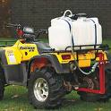
Chemicals
Storage of chemicals:
  Clean, tidy and lockable
  Cupboards/bunding used when required
  Chemicals are segregated when required.
Handling of chemicals:
  Preparation area is well lit and ventilated
  Plenty of bench space to work
  Access to clean water and first aid
Associated equipment:
  Functional, safe and well-maintained
  Related records are current.
Notes:
Your chemical storage area should be:
Kept clean and tidy and should be locked when you are not there to prevent access.
Suitably bunded as required
Able to provide adequate separation and segregation for incompatible chemicals e.g. diesel fuel is not stored close to fertiliser.
Appropriate storage for flammable liquids.
Ventilation may be required for the storage of some chemicals.
When you are handling and using chemicals :
Have a preparation area that is well lit and well ventilated
Have plenty of bench space when decanting or mixing chemicals.
Any decanted or mixed chemicals must be labelled if not used immediately
Have access to plenty of clean water and a first aid kit
Have close access to fire extinguisher/fire blanket, sand bucket and spill kit
Clean up any spills immediately if safe to do so
Never use food or drink containers to store chemicals
Safely dispose of any chemical waste according to the information provided on the label or safety data sheet
The equipment you use with chemicals should:
Be well maintained, functioning and safe to use
Have all related maintenance records kept current.

Slide 13
Asbestos management and BEMIR
The location and condition of asbestos containing materials (ACM) is recorded in the Built Environment Materials Information Register (BEMIR).
Asbestos products shall only be handled by qualified service providers.
All service providers undertaking any maintenance or construction work must obtain a work Area Access Permit (WAAP) issued through BEMIR.
Service provider to certify that work is complete in the WAAP and the space is available for reuse.
Report any changes in the condition of ACM to the administration office.
Notes:
Asbestos is an issue in schools with buildings constructed prior to 1990.
The departmental policy regarding the handling of asbestos is that no EQ staff will handle asbestos containing materials.
The location of asbestos within the school is recorded in the Built Environment Materials Information Register (BEMIR).
Your line manager should assist you to become familiar with the location and nature of any ACMs in your workplace.
Work that may involve asbestos products can only be done by qualified service providers.
All service providers that come onto the school grounds must first go to the Administration Office and obtain a Work Area Access Permit (WAAP) issued from BEMIR.
No work is to be started without this permit.
Service providers are to visit the office after work is completed to certify that work is complete in the WAAP and the space is clean and available for re-use.
Report any changes to the condition/status of the known or suspected asbestos containing materials to the School Administration Office.
You can find out more information about asbestos management on OnePortal: https://intranet.qed.qld.gov.au/Services/facilities/asset-management/education-management/Pages/infrastructure-safety.aspx

Slide 14
Working at heights
There is a prohibition on DoE staff, students and volunteers accessing or working on roofs at all Education Queensland facilities.
You should always attempt to undertake any work heights from ground level or a stable work platform before using other methods.
Working at heights should ONLY be performed by school staff when there are appropriate practices in place to prevent a person from falling.
Notes:
Some of your tasks will require you to work above ground level.
If you do not have appropriate safe work practices in place, the risk of injury dramatically increases.
Falls from heights do cause serious injuries and can be fatal. Schools should contract out work on roofs.
Heights resources can be found on the Creating Healthier Workplaces webpage “Working at Heights” https://education.qld.gov.au/initiatives-and-strategies/health-and-wellbeing/workplaces/safety/hazards

Slide 15
Working at heights
Falls from heights can cause serious injuries.
Do you really need to leave the ground to do a job? e.g.
  retrieving items from roofs; or
  clearing gutters or maintenance work.
If yes, consider:
  the appropriate equipment you will need;
  training where required;
  risk assessment and/or SWMS to do the job; and
  how to minimise the frequency of these tasks.
Notes:
The first question to ask yourself about a task you have to do is “Do I really need to leave the ground to do the job?”
Can I complete the task from ground level.
Some of the tasks you might be asked to do include retrieving items from the roof, clearing gutters, and some maintenance work to some part of the building structure.
It may be possible for you to do the task from the ground with a different tool or piece of equipment, or use contractors.
If you do have to leave the ground, you should discuss the task with your supervisor and then school HSA or WHS Committee about how a task can best be done.
You will need to consider a number of issues including the type of equipment you will need to use, what training or licencing you may need to complete the task safely.
You will also need a risk assessment of the task. The risk assessment may result in a procedure being developed for the task.

Slide 16
Working at heights
Use tools to assist with tasks.
Use contractors – trained people with the right equipment.
Use other equipment to access heights when required e.g. hire equipment.
Stay off ladders if at all possible.
Ensure the ladder is safe if you use one.
Notes:
When a task has to be done by the worker above ground level, a number of things need to be considered:
The complexity of the task and tools being used.
There are lots of options instead of ladders - trestles, planks, mobile scaffolding, Elevated Work Platforms are all options to be considered for tasks
Work from a stable work platform whenever possible.
Avoid using a single side ladder wherever possible. Use a trestle or step platform ladder instead as these are more stable and offer a platform to work from instead of a narrow rung.
Check the ladder over before you use it. There is a checklist in the “Health and Safety for Schools Officers” folder or on the Creating Healthier Workplaces website at https://education.qld.gov.au/initiatives-and-strategies/health-and-wellbeing/workplaces/safety/hazards
Do not use a ladder unnecessarily. Think about alternative methods to do small tasks.
Use the right tools to assist with the task.
If the task is high risk or you require specialist equipment or skills, use external contractors.

Slide 17

Working at heights – minimising risks
What are some options for you to avoid injury?
Trim branches on trees near buildings.
Organise for play areas to be away from buildings.
Use gutter vacs or good quality gutter guard.
Use skilled contractors for work at heights.
Use alternative methods to install/hang items on high walls/ceilings.
Notes:
There are a number of things you can do to minimise the number of times you get up on a ladder.
Trimming branches away from gutters will reduce the number of leaves that fall in the gutter.
Discuss the possibility of using some of these control measures with your School Management as required when managing tasks that may require you to work above the ground.
Organised play areas away from buildings will reduce the number of items that are thrown up on the roof.
Use guttervacs/contractors to clean gutters from the ground.
Get skilled contractors and their specialised equipment for work at heights.
Try to work from the ground or a stable work platform. Consider extension poles, mobile scaffold or a scissor lift.
Try to work from the trestles or mobile scaffold with devices/tools to help you do the job.
You may also be required to work above floor level inside buildings i.e. hanging student art, changing light bulbs. Use alternative methods to do the job from the floor if possible (e.g. use lowering display hooks/fittings; use long life LED light bulbs to reduce the number of times you have to change them).

Slide 18
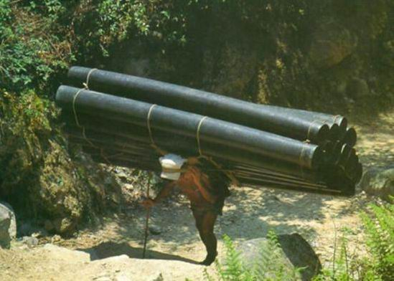
Manual handling
Notes:
Clearly this is something that you would not be expected to do.
But there are manual handling requirements associated with your job.
To prevent injury we need to manage these tasks so that your exposure to the risks of injury associated with the tasks is minimised.

Slide 19
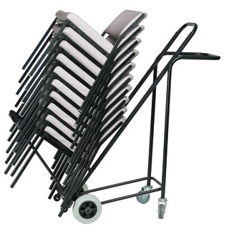

Manual handling
What’s the problem?
Schools officers have very high sprain/strain injury rates
Why?
Because your jobs are physically demanding and made up mostly of manual tasks.
Notes:
Most of the jobs done by Schools Officers includes considerable manual handling.
Poor manual handling practices will result in injuries in both the short and long term.
Manual Tasks are activities which require the use of force exerted by a person to grasp, manipulate, strike, throw, carry, move (lift, lower, push, pull) hold or restrain an object or load.

Slide 20
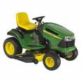
Manual handling – injury causes
Exertion
  Moving furniture, gardening
Awkward or sustained positions
  Mowing/slashing
  Maintenance work (reaching above head)
Long duration or high repetition
Vibration
  Tool use
  Tractors/mowers
Notes:
Injuries are caused by the direct factors acting on the body. These factors are:
Exertion
Awkward or sustained postures
Long Duration or repetition
Vibration
In your work environment, exertion does not just mean heavy lifting, it talks about all activities that require increased effort such as moving furniture or gardening.
In fact, many of your daily tasks will include exertion.
Awkward or sustained positions do not have to feel uncomfortable, it can be as simple as sitting in the same position for a period of time.
They may include positions that would not be considered as good posture such as being bent over, holding your arms above shoulder height, reaching or twisting.
These sort of positions usually make our muscles tire more quickly.
It is important to give your body relief from awkward or constant postures and give those muscle groups a rest and use other muscle groups to perform other tasks.
Long duration could be considered as anything over two hours, however even sitting mowing for an hour can be uncomfortable and a short break may be needed.
High repetition is a short task that is repeated over and over in a short space of time.
Vibration can be either whole-body such as vibration through a seat of a mower/tractor or hand/arm vibration when you use tools.

Slide 21

Manual handling – preventing injury
Design the job so it is easier:
  The way it is done (order, delivery, tools)
  Where the task is done (closer, more comfortable, away from other).
  Use equipment or mechanical assistance to help you (trolley, cart, long-handled tool for leverage).
Manage your exposure to the risks:
  Organising the work (breaking up the tasks during the day)
  Task-specific training (making sure you are doing it in the best possible way).
Notes:
To prevent an injury, one way is to train you in good lifting technique but we all know that every situation is different, and it is impossible to use good “technique” all the time.
Plus we get fatigued throughout the day with repetitive, physical tasks.
Instead, our primary focus should be on developing safe work practices and the best way to achieve this by re-designing the job.
A new job design looks at the way the job is performed, the work area and the equipment used to perform a task.
Changes minimise the risks and when implemented can make permanent improvements.
Any suggested changes should be discussed with school management.
Management (or administrative) controls include training and work organisation such as scheduling of tasks during the day and week.
These changes rely on us as individuals to make them work for us so they are often less effective than design controls.
Better task management can be used in addition to improved job design and as a short term option until more expensive / complex controls are implemented.

Slide 22

Manual handling
Don’t lift or handle more than can be easily managed.
There is a difference between what you can lift and what you can safely lift.
If in doubt, get help.
Notes:
Do not over-estimate your capacity to handle loads.
It is better to err on the side of caution than to put your self at risk.
If you are unsure about moving or lifting a load, it is probably too much for you. Get some assistance from a mechanical device or another person.

Slide 23

Manual handling
What can you do to make your work safer?
Think about each task
Plan the task – and plan each lift
Use team lifting and mechanical devices
Plan your day for variety
Rest and alternate use of muscle groups
Maintain good posture
Do NOT put yourself at risk.
Notes:
These are some important points to think about before you start any jobs that involve manual tasks.
Think about the job you are about to do and try to identify any hazards that might be associated with the job i.e. heavy weights, poor posture, repetition.
Plan the job so that those hazards will be managed to minimise the risk of injury to you and anyone else that might be affected by your work.
Get some assistance, either mechanical or human, to do the manual tasks if there are large weights involved.
Do more than one job each day. e.g. don’t mow all day non-stop. Break up mowing over the day or week with other tasks that require a different posture.
Plan for variety so that the risk of injury is minimised by reducing the time and/or repetitions in any particular task.
Plan the job and your day so that you can alternatively rest and use large muscle groups.
Job variety helps to keep you fresher through the day.
Maintain good postures through out the day. Try to eliminate excessive reaching, stretching, bending and twisting, by planning what you are doing and using the right equipment and set up.
Break up, space out or share high frequency or repetitive tasks and long tasks that include vibration to give your muscles time to relax and rest.

Slide 24

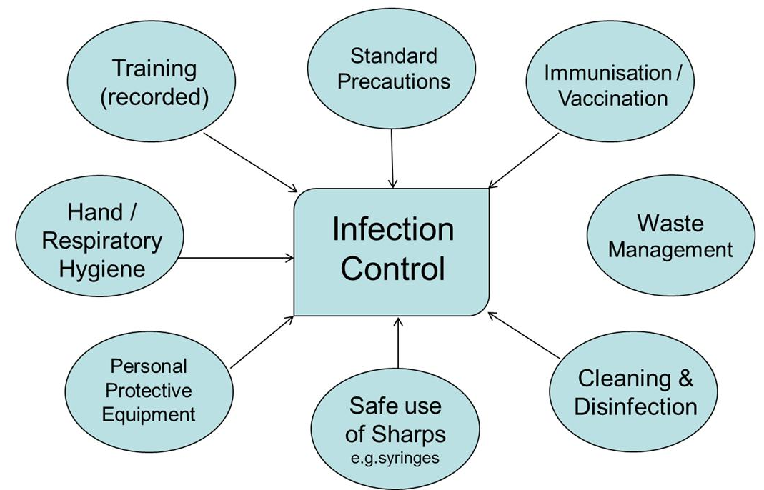

Infection control
Due to their nature, DoE workplaces such as schools can be natural amplifiers of infectious disease e.g. large numbers of people congregating in close proximity on a daily basis.
An infection control program is important to minimise the spread of infectious disease.
Notes:
You may be required to be involved in cleaning up potentially infectious waste from time to time.
There are resources on the “Health and Safety for Schools Officers” page that provide information about the safety precautions required to undertake a number of these tasks.
All infection control requirements must be in place before you undertake any of these tasks.
Take some time to go through the materials.
https://education.qld.gov.au/initiatives-and-strategies/health-and-wellbeing/workplaces/safety/managing/school-officers
You can also download and print posters for hand washing and safe removal of disposal gloves from https://education.qld.gov.au/initiativesstrategies/Documents/handwash-glove-remove-post.pdf

Slide 25
Infection control
What are standard precautions?
Assume that all blood and bodily fluids/substances are potentially infectious and therefore apply:
  good hygiene including hand washing;
  use of PPE;
  appropriate waste disposal;
  cleaning and sanitation; and
  know your immunisation status (e.g. all common childhood illnesses as well as Hepatitis A and Hepatitis B).
Notes:
When managing infectious materials, you should always take standard precautions.

Slide 26
Infection control
Infectious diseases may be:
  Blood borne e.g. Hepatitis B;
  Airborne/droplet e.g. Influenza, COVID-19
  Transferred via contact e.g. Gastroenteritis
Control measures to prevent infection are based on the method of transmission.
Schools officers are considered at risk of contracting Hepatitis A and B and are therefore able to access school funded vaccination.
Notes:
Further information about infection control is available from the Creating Healthier Workplaces Infection control page: https://education.qld.gov.au/initiatives-and-strategies/health-and-wellbeing/workplaces/safety/hazards

Slide 27
How do you keep safe?
Most incidents can be avoided.
Rules are not made to be broken.
You have responsibilities to yourself and others to work safely in a healthy and safe environment.
Know what is happening around you.
Comply with your legal duties.
Report potentially dangerous situations or practices.
Remove, cover, signpost or barricade hazards where practical – don’t leave it for others.
Notes:
There is plenty of legislation, policy and procedure in place to make the workplace as safe as possible for us,
However, it is up to us as workers to do our bit to make a safer workplace.
It is about coming to work with the right attitude to working safely each day.
Each of these points will help to contribute towards a positive attitude and your own safety:
Make sure that your attitude to safety is positive when you start work each day and strive to maintain good practices all day.
Model safe working practices for others to observe.
Rules have been developed because they are the right thing to do, not to break.
Follow them for your personal safety.
If you follow the rules and use your training, skills and experience you will minimise the risk of injury in your tasks.
The majority of incidents can be avoided if you think about your job.
Keep your eyes and ears open.
Students can easily come close to you when you are working and could be at risk of injury from your activities.
Don’t forget about your workplace health and safety duties and what you need to do to fulfil your obligation.
Report any potentially dangerous situation or hazard that you identify. Do not leave it for anyone else to report.
Do something about it immediately if you can. You still need to report it even if you have done something about it.

